Slide 2

Water System Master Plan - Summary Presentation
City of East Moline
November 4, 2024

Slide 3
Presentation Outline
Condition of Existing Facilities
Major Findings
Prioritized Capital Improvement Plan
CIP projects driven by condition, age, and regulatory requirements.

Slide 4
Existing Water System
Raw Water Pumping Station
Water Treatment Plant
21st Avenue Pumping Station
Elevated Storage Tanks
Distribution System

Slide 5
Condition Assessments
Condition evaluated based on visual assessment, age, and maintenance history.
RWPS is in fair condition with some equipment in poor condition.
Needs new electrical gear and replacement of the PAC system.
WTP is in fair to good condition and is expected to last another 15 to 20 years with ongoing maintenance.
Chemical system modifications would bring areas into compliance with current codes.

Slide 6
Condition Assessments
RWPS and WTP require improvements to prolong equipment life.

Slide 7
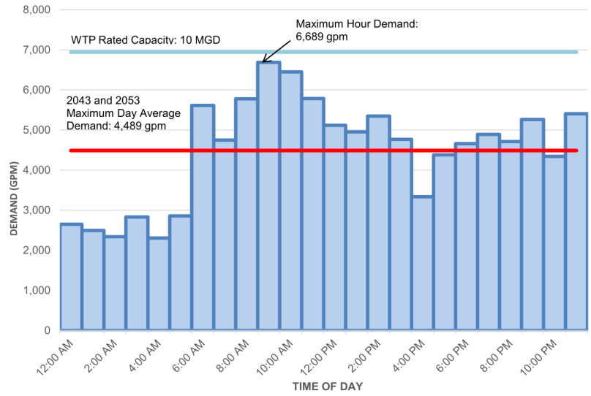
Historical and Projected Water Demands
Population projections show flat growth
Average Day Demand ~4.4 MGD
Maximum Day Demand ~6.5 MGD
Treatment and pumping capacities sufficient for existing and future demands

Slide 8
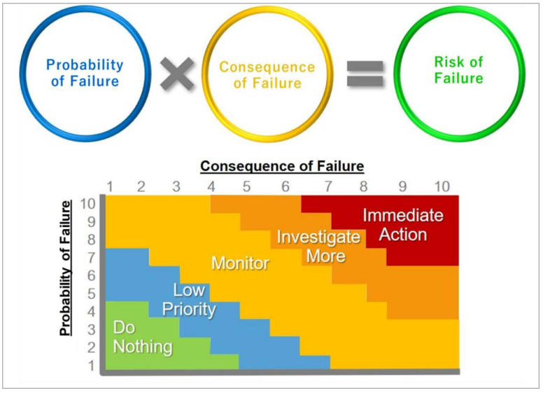
Asset Management
Overall risk scores for vertical assets and distribution system confirmed condition assessments
Based on the probability of failure and consequences of failure for assets

Slide 9
Operations Review
Compared East Moline water department Full Time Equivalent staffing to industry standards
17.5 FTE employees
Compared to AWWA standards data suggests additional staff may be warranted
USEPA’s Lead and Copper Rule Revisions and Improvements
PFAS regulations
Add up to six FTE employees to stay in range

Slide 10
Annual Water Main Replacements
Currently replacing ~0.3% of the system each year.
Would take 333 years to replace all pipes (some pipes would be >300 years old before replacement)
Risk-based approach recommended by AWWA used to estimate replacement needs.
Increasing replacement to 4% per year for seven years to address critical areas. Annual cost of $10 to $12 million.

Slide 11
Critical Needs Over Next 10 Years
Major Needs over Next 10 Years | Projected 10-yr Cost in Water Master Plan | Projected Alternative 10-yr Cost
LSL Replacement Mandate | $22,932,000 | $22,932,000
Clearwell Replacement | $15,000,000 | $15,000,000
WTP Maintenance, Replacements, Repairs | $13,780,000 | $13,780,000
Administration and Garage Facility | $13,000,000 | $0
Water Main Replacement Program | $95,000,000 | $54,000,000
Total | $159,712,000 | $105,712,000

